Slide 1
CMP5329 Cyber Security
Week 2-P2: Data Authentication-Secure Hash Function
PhD. Ngoc-Tu Nguyen
tunn@uit.edu.vn

Slide 2
Security goals
Goals
Cipher systems
- Symmetric (DES, AES)
- Asymmetric (RSA, ECC, CRYSTALS-KYBER)
Confidentiality
Privacy
Integrity
Hash functions
Message authentication code (MAC)
Digital signature (digital certificate)
Authentication
Non-repudiation (Accountability)
Access control
RBAC, ABAC, PBAC
Availability

Slide 3
Motivations
(2) MITM
A
B
(1)
propagation errors!
Who are we communication with?
Does the destination data original form?
Needs:
a way to ensure that data arrives at destination in its original form sent by the sender;
it is coming from an authenticated source (user, server, mediate node).
Notes:
Modified ciphertext can often still be decrypted into plaintexts?

Slide 4
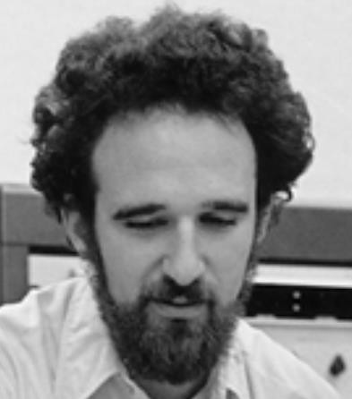
















Motivations
$$Q_{A}$$
$$(a,Q_{A}=aG)$$
$$Q_{B}$$
$$(b,Q_{B}=bG)$$
$$sk=aQ_{B}=bQ_{A}=abG$$
Bob
Alice
Need authentication entities
man-in-the-middle attack!
$$mG$$
$$aG$$
$$mG$$
$$bG$$
$$(a,Q_{A}=aG)$$
$$(b,Q_{B}=bG)$$
$$sk_{1}=amG$$
$$(m,Q_{M}=mG)$$
$$sk_{2}=bmG$$

Slide 5
Cryptographic Ciphers
Symmetric Cipher (DES, AES)
Asymmetric Cipher (RSA, ECC, ElGamal)
can provide which security services?
Confidentiality ☑
Integrity 
Privacy ☑
Authentication 
Non-repudiation 
Availability 

Slide 6
Hash function and MACs
Hash function
Message Authentication Codes (MAC)
Digital signature
Digital certificate
symmetric
asymmetric
Integrity ☑
can provide
Authentication ☑
Availability ☑
Further reading (Wikipedia)
Cryptographic Hash Functions
Message Authentication Code
Non-repudiation ☑

Slide 7



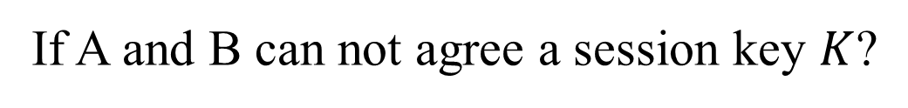

Motivations
How to ensure that the message is the original one?
How to verify that a message comes from the claimed sender?
Integrity?
Authentication?
Message Authentication Code (MAC)
If A and B can not agree a session key $K$?
Alice
Bob
$$M, tag=CRC$$
$$send M?$$
$$M^{′},tag^{′}=?tag$$
attacks?
$$M=M′$$

Slide 8
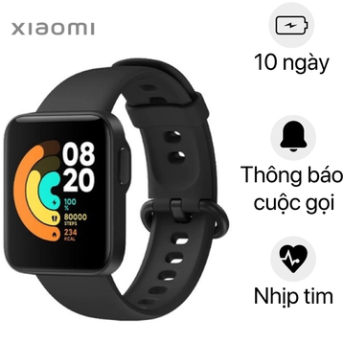




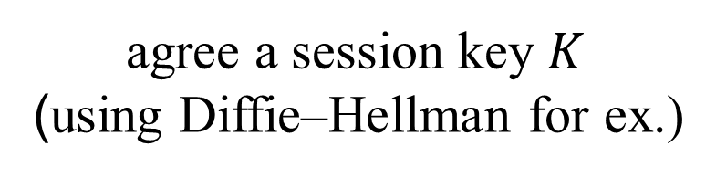


Motivations
How to ensure that the message is the original one?
How to verify that a message comes from the claimed sender?
Integrity?
Authentication?
MAC, HMAC
agree a session key $K$
(using Diffie–Hellman for ex.)
Health care system
server
Elder
$$K$$
$$K$$
$$M, tag=HMAC\left(K,M\right)=H(K,M)$$
$$send M?$$
$$M^{′},tag$$
$H\left(K,M^{′}\right)=?tag=$ $H\left(K,M\right)$
$$M=M′$$

Slide 9
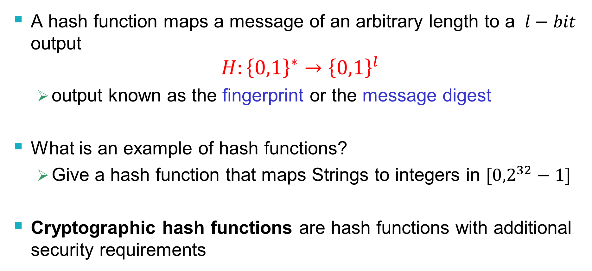
Hash Functions
A hash function maps a message of an arbitrary length to a $l−bit$ output
$$H:{\left\{0,1\right\}}^{∗}→{\left\{0,1\right\}}^{l}$$
output known as the fingerprint or the message digest
What is an example of hash functions?
Give a hash function that maps Strings to integers in $[{0,2}^{32}−1]$
Cryptographic hash functions are hash functions with additional security requirements
Notes:
Example hash function: v:=1; for each character c, v=v*(c+1)+2 mod 2^{32};

Slide 10
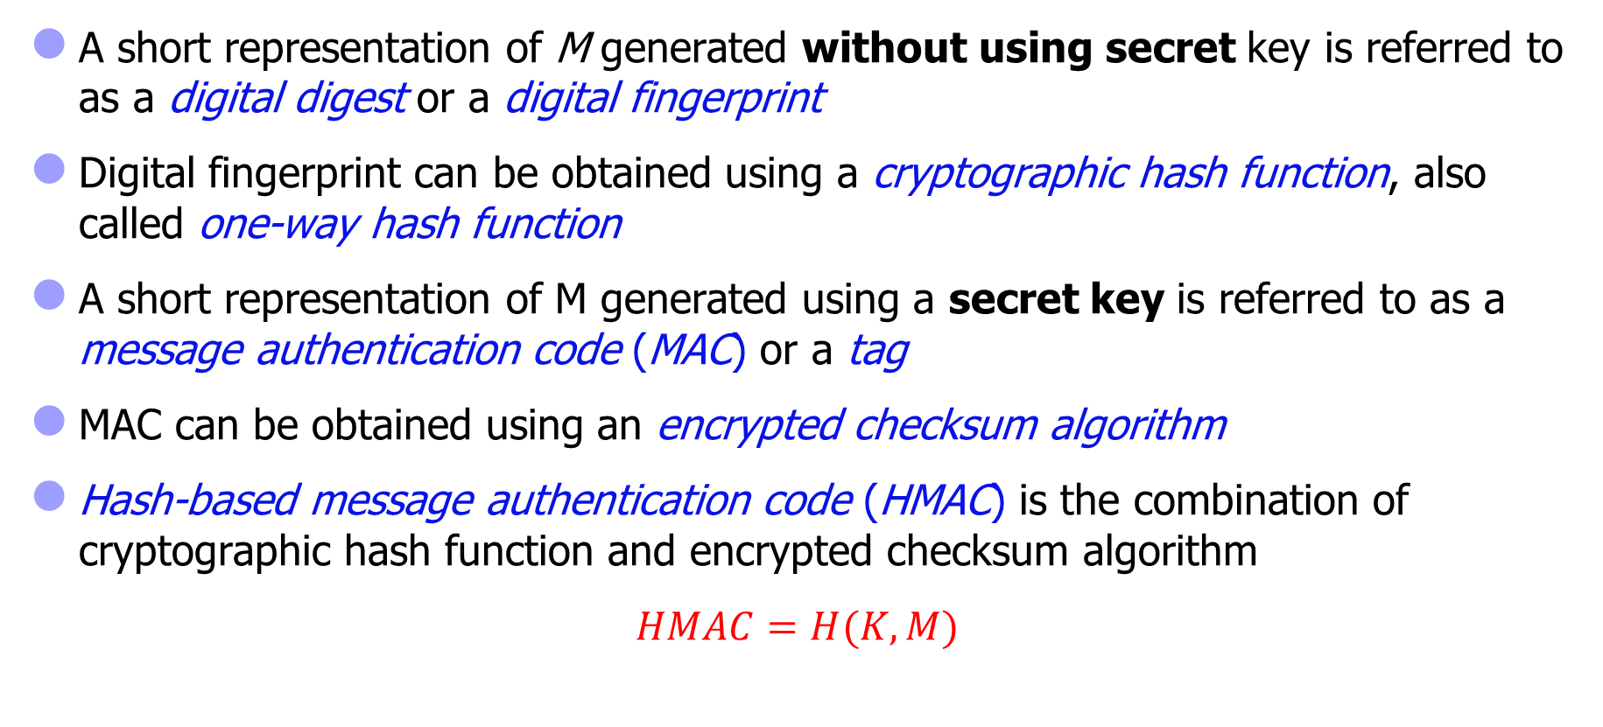
Some terminology
A short representation of M generated without using secret key is referred to as a digital digest or a digital fingerprint
Digital fingerprint can be obtained using a cryptographic hash function, also called one-way hash function
A short representation of M generated using a secret key is referred to as a message authentication code (MAC) or a tag
MAC can be obtained using an encrypted checksum algorithm
Hash-based message authentication code (HMAC) is the combination of cryptographic hash function and encrypted checksum algorithm
$HMAC=H(K,M)$

Slide 11
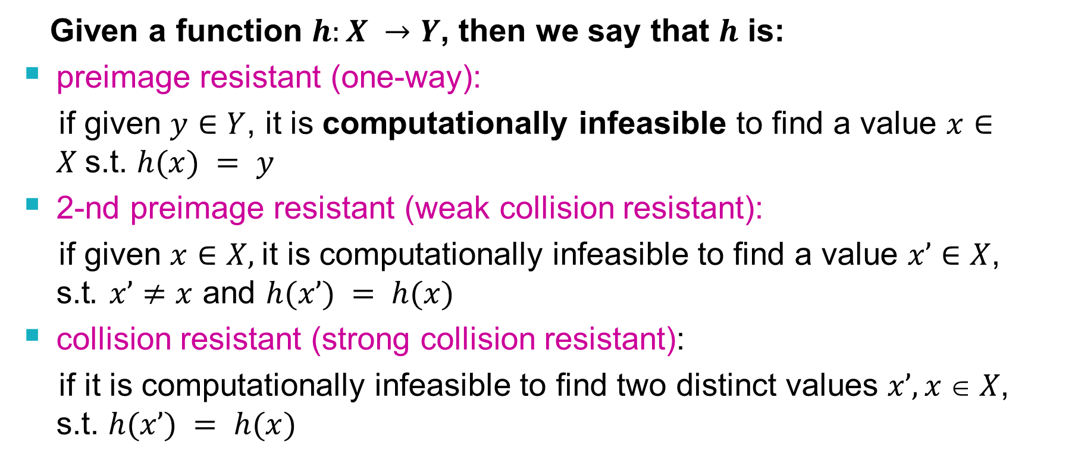
Cryptographic Hash Functions
Given a function $h:X →Y$, then we say that $h$ is:
preimage resistant (one-way):
if given $y∈Y$, it is computationally infeasible to find a value $x∈X$s.t. $h(x) = y$
2-nd preimage resistant (weak collision resistant):
if given $x∈X,$it is computationally infeasible to find a value $x’∈X$, s.t$. x’≠x$ and $h(x’) = h(x)$
collision resistant (strong collision resistant):
if it is computationally infeasible to find two distinct values $x’,x  X$, s.t. $h(x’) = h(x)$

Slide 12
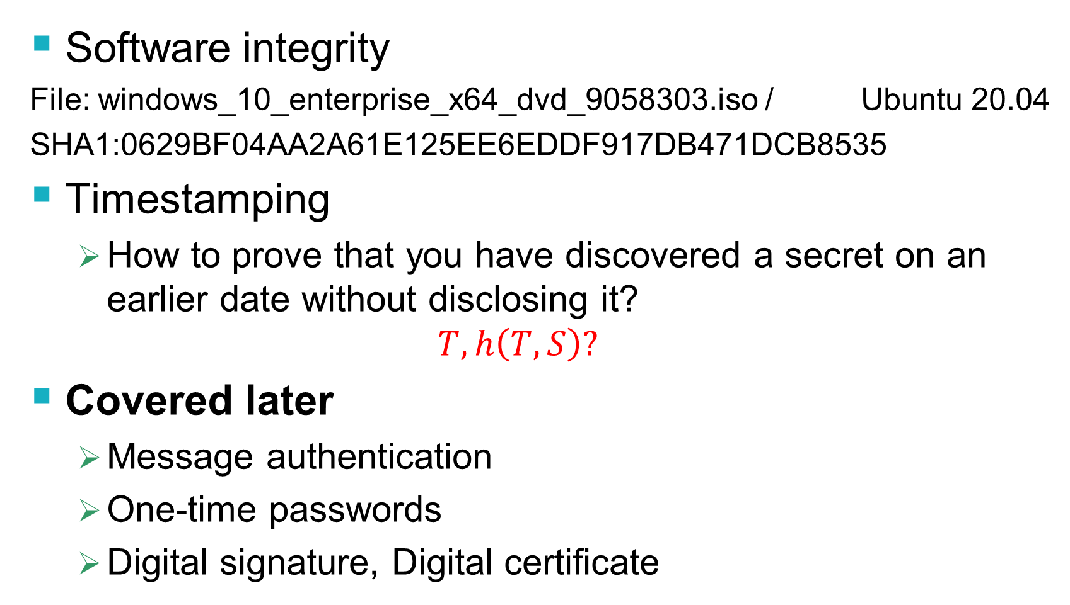
Usages of Cryptographic Hash Functions
Software integrity
File: windows_10_enterprise_x64_dvd_9058303.iso / Ubuntu 20.04
SHA1:0629BF04AA2A61E125EE6EDDF917DB471DCB8535
Timestamping
How to prove that you have discovered a secret on an earlier date without disclosing it?
$$T, h\left(T,S\right)?$$
Covered later
Message authentication
One-time passwords
Digital signature, Digital certificate
UBUNTO 20 ISO
Further reading
https://en.wikipedia.org/wiki/Cryptographic_hash_function

Slide 13


Using Hash Functions for Message Integrity
Is this secure scheme (M cannot be modified)?
Case 1:
Case 2:
$$M, h(M)$$
UBUNTO 20 ISO
$$M$$
$$h\left(M\right) (secure channel)$$
Case 3:
$$K$$
$$K$$
$M$, $h(K, M)$

Slide 14
Well Known Hash Functions
MD5 (phased out)
output 128 bits
collision resistance completely broken
SHA1 (phased out)
output 160 bits
collision attacks; length extension attacks
SHA2 (SHA-224, SHA-256, SHA-384, SHA-512)
outputs 224, 256, 384, and 512 bits, respectively
collision attacks; length extension attacks
SHA3
https://csrc.nist.gov/publications/detail/fips/202/final https://en.wikipedia.org/wiki/Secure_Hash_Algorithm

Slide 15
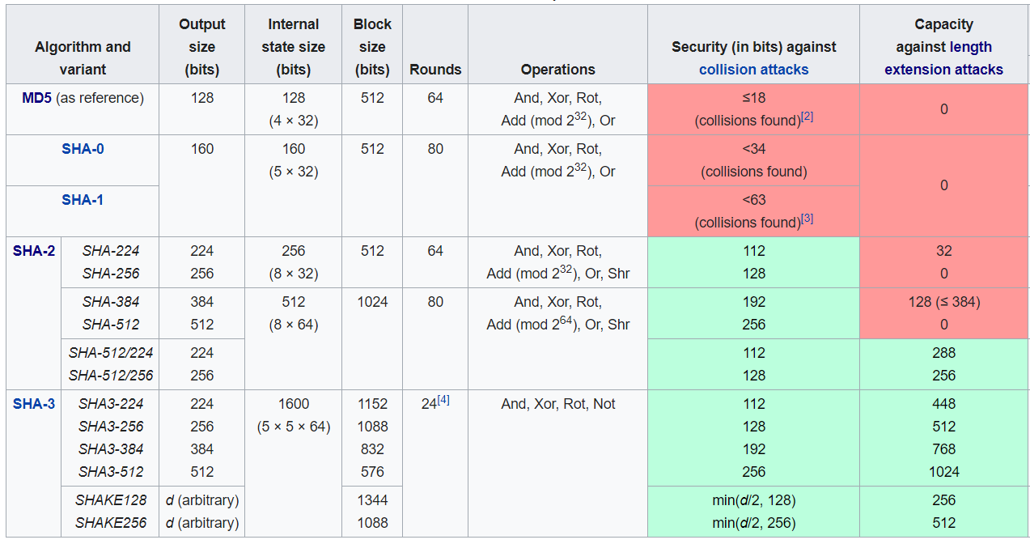
SHA-1, SHA-2, SHA-3
https://en.wikipedia.org/wiki/Secure_Hash_Algorithms

Slide 16
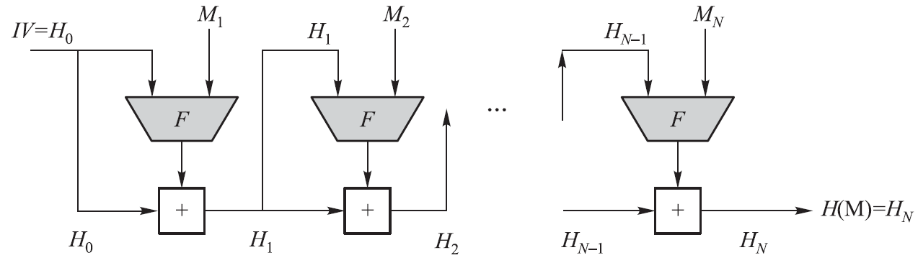
Merkle-Damgard Construction for Hash Functions
SHA-1, SHA-2 (a series of hash functions), and WHIRLPOOL all have the same basic structure
The heart of this basic structure is a compression function F
Different hash algorithms use different compression functions
Use a CBC mode of repeated applications of F without using secret keys
M is a plaintext block, IV is an initial vector, F is a compression function, and “+” is some form of modular addition operation
Notes:
CBC=Cipher block chaining

Slide 17
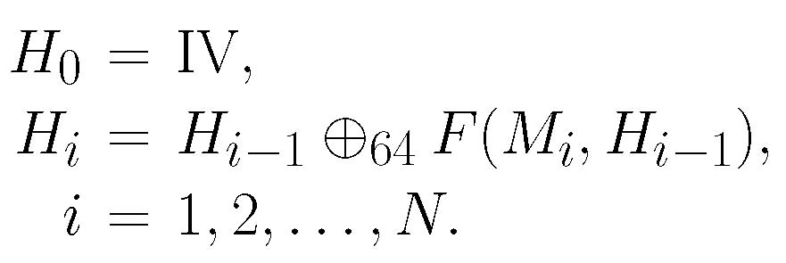
Merkle-Damgard Construction for Hash Functions
The M’s digital fingerprint is H(M) = H_{N}, where
SHA-512
Notes:
CBC=Cipher block chaining

Slide 18


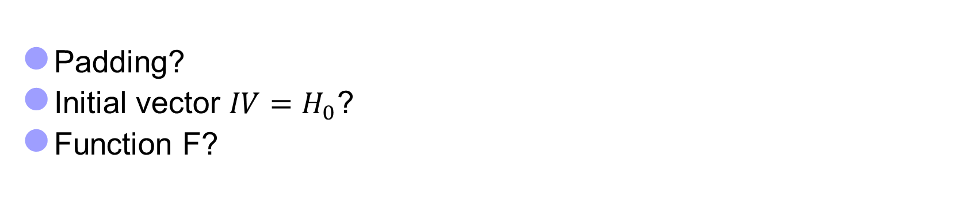
SHA-512 Algorithm
Let X = X₁X₂…X_{k}, Y = Y₁Y₂…Y_{k} be binary strings, where each X_{i},Y_{i} is an l-bit binary string. Generalize the bitwise-XOR operation to an l-bitwise-XOR operation as follows:
For SHA-512: $l=64$
Padding?
Initial vector ${IV=H}_{0}$?
Function F?
Y
X

Slide 19
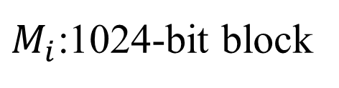
SHA-512 Initial Process (I)
Padding process
M M’= M₁M₂…M_{N}
$M_{i}$:1024-bit block
1024 bits
1024 bits
1024 bits?
Length(M)=L
M’ = M || 1(0^{l}) || b₁₂₈(L), where l ≥ 0

Slide 20
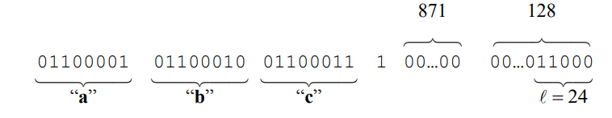
SHA-512 Initial Process (I)
Padding process
Example: M=abc
M’ (1024 bits)
Length(M)=24
M’ = M || 1(0^{l}) || b₁₂₈(L), where l =1024 -24 -1 -128 = 871
L

Slide 21
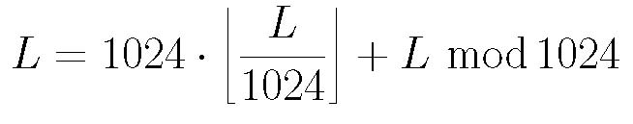
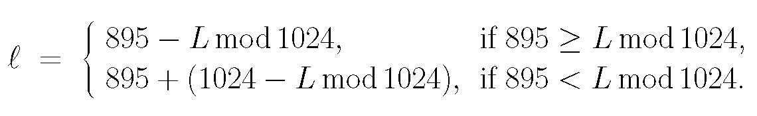

SHA-512 Initial Process (II)
Set Γ = 2¹²⁸ – 1 and γ = 512
M is a binary with |M| = L ≤ Γ
Represent L as a 128-bit binary string, denoted by b₁₂₈(L)
Pad M to produce a new binary string M’ as follows:
M’ = M || 1(0^{l}) || b₁₂₈(L), where l ≥ 0
such that |M’| (denoted by L’) is divisible by 1024. We have
L’ = L + (1 + l) + 128 = L + l + 129 = L + (1024 – 895) + l
L can be represented as
Hence, l can be determined as follows:
Thus, L’ is divisible by 1024. Let L’ = 1024N and write as a sequence of 1024-bit blocks: M’ = M₁M₂…M_{N}
Padding process
M M’
M’ = M || 1(0^{l}) || b₁₂₈(L),
where l ≥ 0
M’ = M₁M₂…M_{N}
$$len(M_{i}) =1024$$

Slide 22
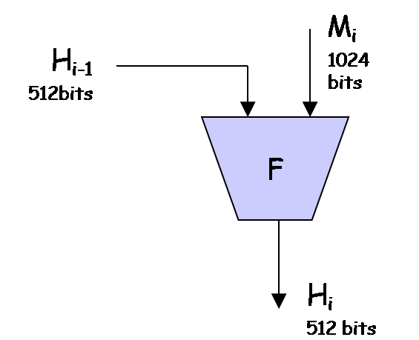

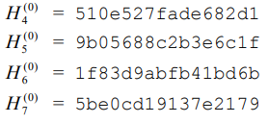


SHA-512 Initial Process (II)
SHA-512 uses a 512-bit IV
Let r₁, r₂, r₃, r₄, r₅, r₆, r_{7,} and r₈ be eight 64-bit registers
Initially they are set to, respectively, the 64-bit binary string in the prefix of the fractional component of the square root of the first 8 prime numbers:
√2, √3, √5, √7, √11, √13, √17, √19
$$H^{(0)}=\text{IV}$$

Slide 23
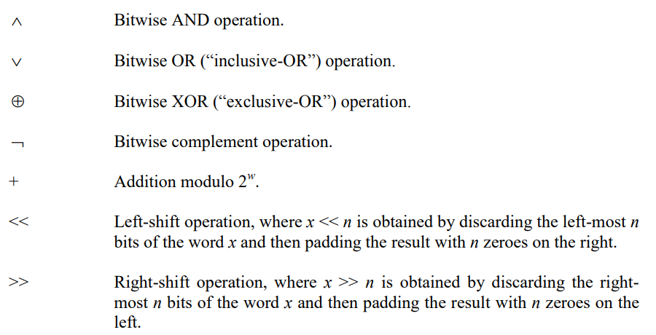
SHA-512 Compression Function (III)

Slide 24
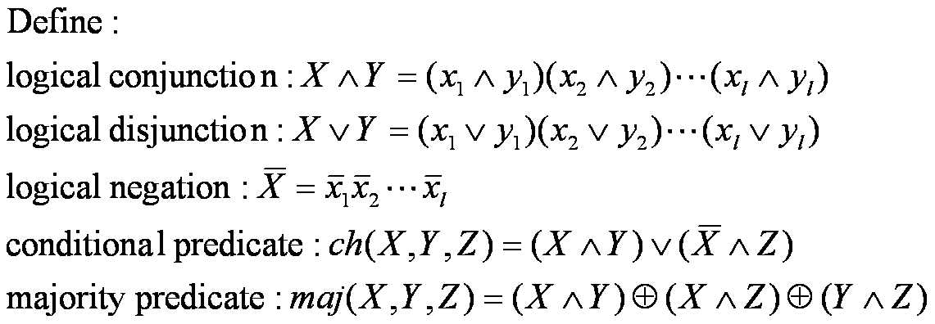
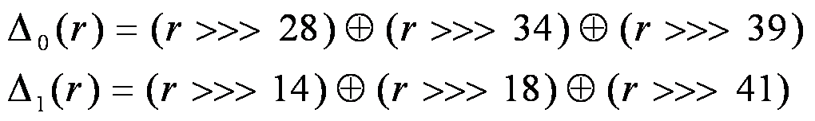
SHA-512 Compression Function (III)
Bitwise operations

Slide 25
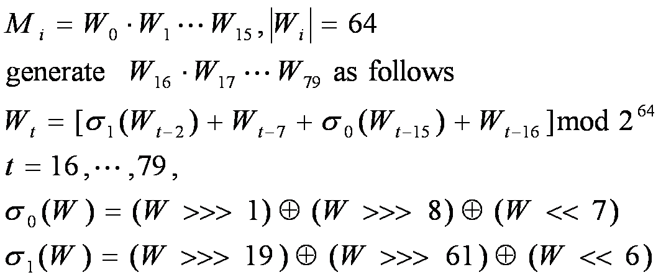
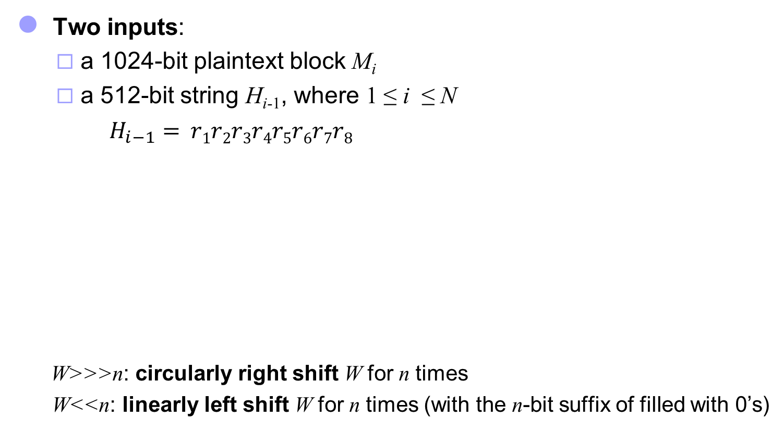
SHA-512 Compression Function (IlI)
Two inputs:
a 1024-bit plaintext block M_{i}
a 512-bit string H_{i-1}, where 1 ≤ i ≤ N
$H_{i−1}= r1r2r3r4r5r6r7r8$
W>>>n: circularly right shift W for n times
W<<n: linearly left shift W for n times (with the n-bit suffix of filled with 0’s)

Slide 26

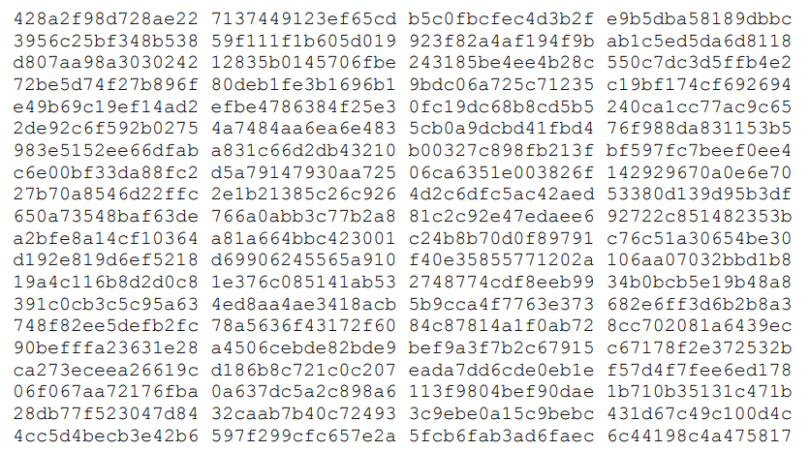
SHA-512 Compression Function (III)
: first sixty-four bits of the fractional parts of the cube roots of the first eighty prime numbers

Slide 27
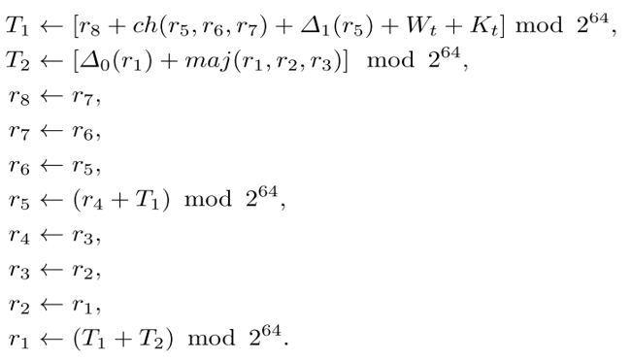

SHA-512 Compression Function (III)
$H_{i−1}= r1r2r3r4r5r6r7r8$, $W_{0},$ $W_{1},…,W_{79}$, $K_{0},$ $K_{1},…,K_{79}$
For each i is executed 80 rounds:
t=0,1,2,..79
After 80 rounds of executions, the output is 512-bit string
$F(Mi, H_{i−1} ) = r1r2r3r4r5r6r7r8$

Slide 28




Length extension attack on SHA2
$$EX$$
$$H_{N}$$
$$H^{∗}$$
$$H$$
$$H(K||M)=H(K||M||padded)$$
$$H(K||M||padded||EX) =H^{∗}(EX)$$
can compute $H(M||padded||EX)$without knowing the input $M$

Slide 29
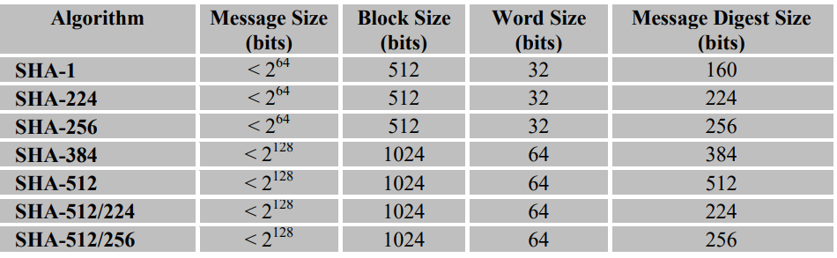
SHA-1, SHA-2
Merkle-Damgard Construction

Slide 30
Length extension attack on SHA2
$$EX$$
$$H_{N}$$
$$H^{∗}$$
$$H$$
$$H(K||M)=H(K||M||padded)$$
$$H(K||M||padded||EX) =H^{∗}(EX)$$
can compute $H(M||padded||EX)$without knowing the input $M$

Slide 31
Length extension attack on SHA2
$h(K||M||padded||EX$)?
$$EX=M_{ex1}|\left|M_{ex2}\right||…$$
$$M_{ex1}$$
$$H(K||M)=H(K||M|\left|padded\right)=H_{N}$$
Compute $H(K||M||padded||EX)$without knowing the input $K, M$
$$H\left(K||M\left|\left|padded\right|\right|EX\right)=H^{∗}\left(EX\right),$$
where IV of $H^{∗}=H_{N}$

Slide 32
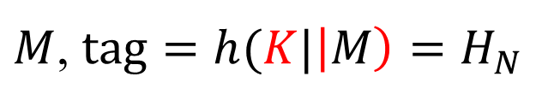
Length extension attack on SHA2
$$K$$
$$K$$
$M$, $tag=h(K|\left|M\right)=H_{N}$
${M→M}^{′}=M\left|\left|padding\right|\right|EX$, ${tag}^{′}=h\left({K||M}^{′}\right)=h^{∗}(EX)$
$$K$$
$$K$$
$M$, $tag=h(K|\left|M\right)=H_{N}$
$M′$, $tag′=h^{∗}(EX)$
$$H_{N}$$
$$M_{ex1}$$
$$M_{ex2}$$
$h\left({K||M}^{′}\right)=h(K||M||padding||EX$)= $h^{∗}(EX)$
$$EX=M_{ex1}|\left|M_{ex2}\right||…$$
$$H_{N+1}$$

Slide 33
SHA3 Standard
SHA-3 provides an alternative to SHA-2, and is drop-in compatible with any system using SHA-2
SHA-3 uses a sponge construction, instead of the CBC mode of repeated compressions used by SHA-1, SHA-2, and Whirlpool
https://nvlpubs.nist.gov/nistpubs/FIPS/NIST.FIPS.202.pdf

Slide 34
NIST SHA-3
2007: Request for submissions of new hash functions
2008: Submissions deadline. Received 64 entries. Announced first-round selections of 51 candidates.
2009: After First SHA-3 candidate conference in Feb, announced 14 Second Round Candidates in July.
2010: After one year public review of the algorithms, hold second SHA-3 candidate conference in Aug. Announced 5 Third-round candidates in Dec.
2011: Public comment for final round
2012: October 2, NIST selected SHA3
Keccak (pronounced “catch-ack”) created by Guido Bertoni, Joan Daemen and Gilles Van Assche, Michaël Peeters

Slide 35
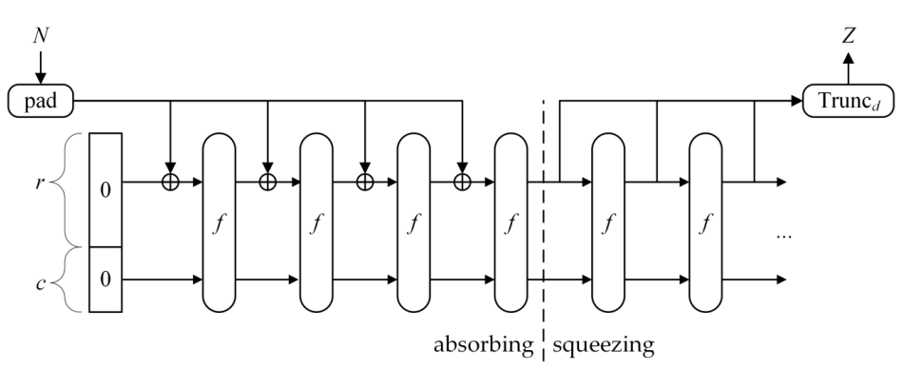
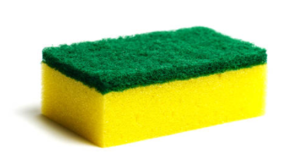
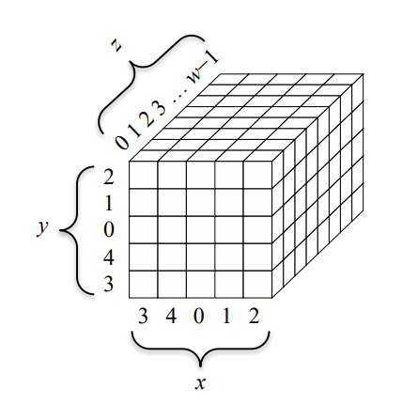
SHA3 Standard
Sponge construction (Keccak)
$$P_{0}$$
$$P_{1}$$
$$…$$
$$P_{N−1}$$
r (block size)
c=2d = 2.(output length)
Let M be the input string; d = the hash length.
b = r + c, where c = 2d
r is called rate and c capacity
Where
Bertoni, G., Daemen, J., Peeters, M., Van Assche, G., & Van Keer, R. (2012). Keccak implementation overview. URL: http://keccak. neokeon. org/Keccak-implementation-3.2. pdf.

Slide 36
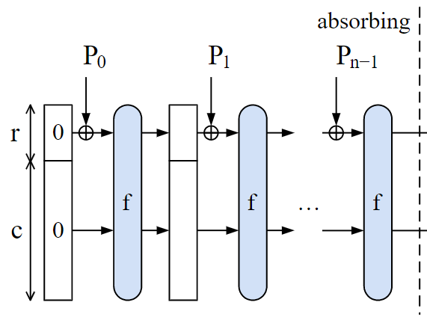
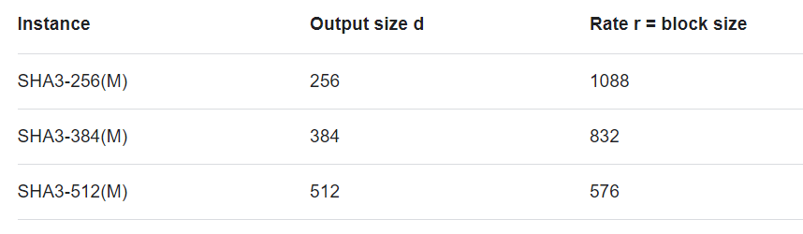
Example
Let M be the input string; d = the hash length.
b = r + c, where c = 2d
r (block size) is called rate, and c=2d capacity
Where
Ex. d = 512, then c = 1024.
Choose b = 1600, then r = 576.
2d
$∥P_{0}∥=∥P_{1}∥$=… $∥P_{N−1}∥=r$

Slide 37
Setup
Pad M by appending 1{0}*1 to produce M’ such that |M’| is divisible by r.
Divide M’ into N = |M’|/r blocks: M₁, …, M_{N}
Let A be a b-bit string and denote A as a 5X5 matrix
Let a_{i,j,k} denote the k^{th} bit in a_{i,j}
Let f_{b} be a fixed-length permutation on b-bit inputs
Let p_{r} = pfx_{r}, s_{c} = sfx_{c}
$$A={\left(ai,j,k\right)}_{5×5×w}$$

Slide 38
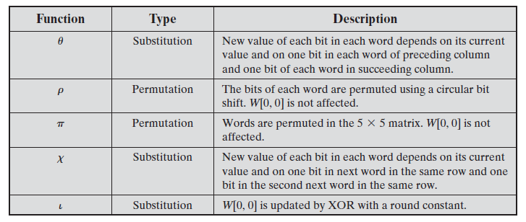
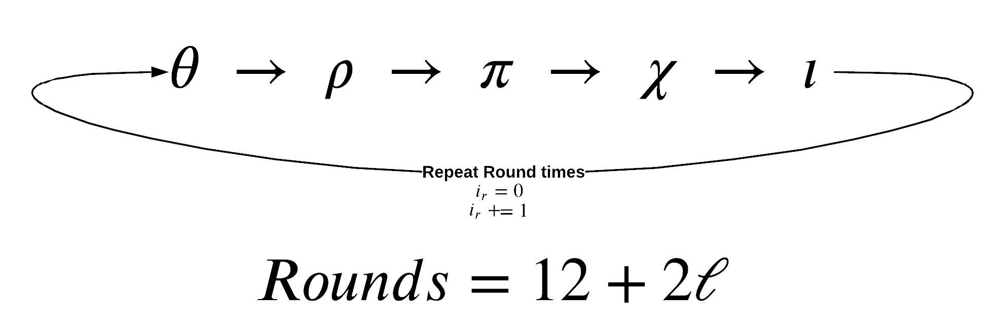
Absorb and Squeeze
https://chemejon.io/sha-3-explained/

Slide 39

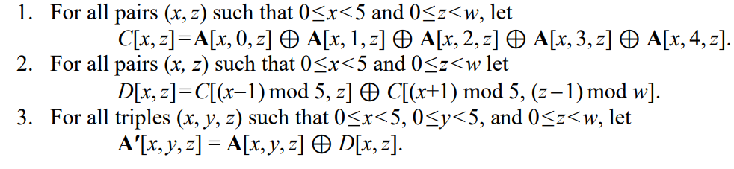
Absorb and Squeeze
A
https://nvlpubs.nist.gov/nistpubs/FIPS/NIST.FIPS.202.pdf

Slide 40


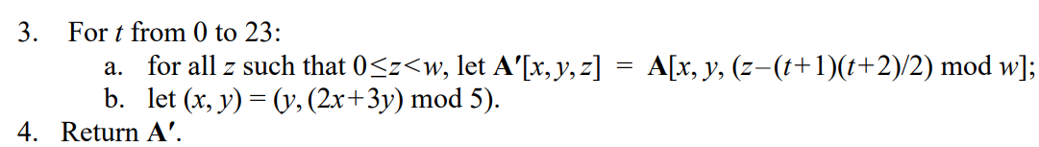
Absorb and Squeeze
A
https://nvlpubs.nist.gov/nistpubs/FIPS/NIST.FIPS.202.pdf

Slide 41

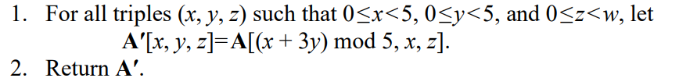
Absorb and Squeeze
A
https://nvlpubs.nist.gov/nistpubs/FIPS/NIST.FIPS.202.pdf

Slide 42

Absorb and Squeeze
A
“.” “ integer multiplication
https://nvlpubs.nist.gov/nistpubs/FIPS/NIST.FIPS.202.pdf

Slide 43

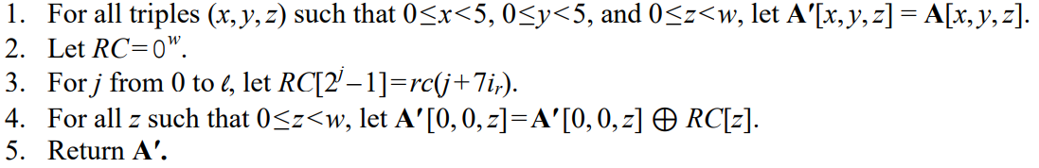
Absorb and Squeeze
A
https://nvlpubs.nist.gov/nistpubs/FIPS/NIST.FIPS.202.pdf

Slide 44

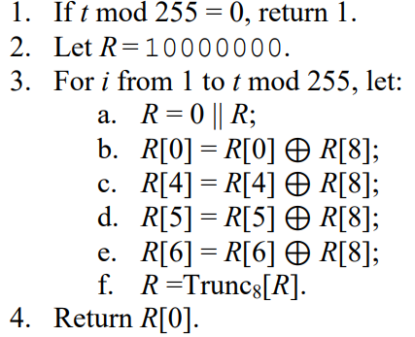
Absorb and Squeeze
round constant
A

Slide 45



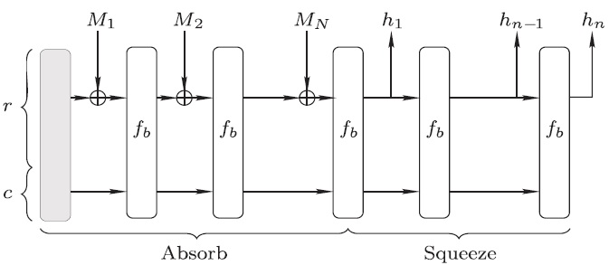
Absorb and Squeeze
Absorb:
Squeeze:

Slide 46
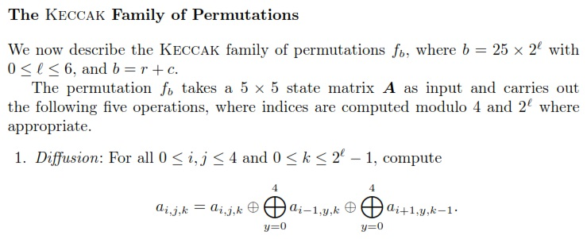
SHA-3 Hash
Permitation $f_{b}(b)$

Slide 47
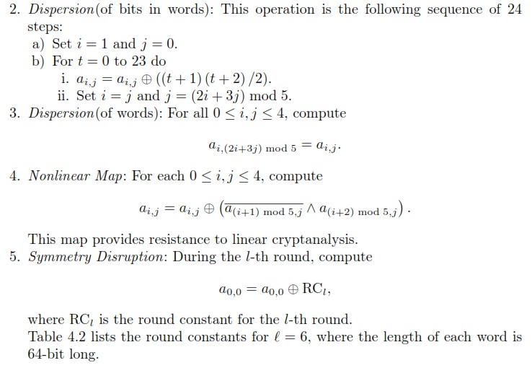
SHA-3 Hash

Slide 48
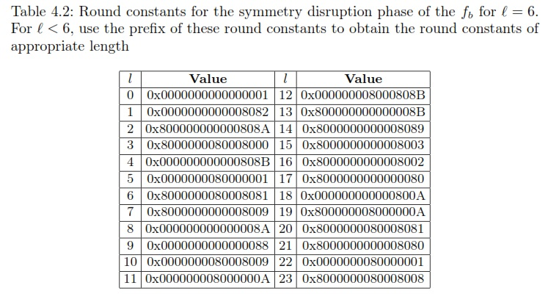
SHA-3 Hash

Slide 49
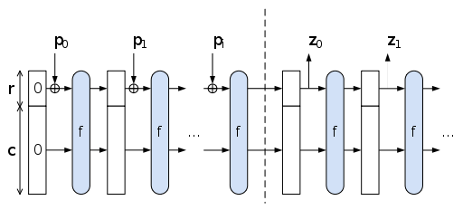
The Sponge Construction: Used by SHA-3
Each round, the next r bits of message is XOR’ed into the first r bits of the state, and a function f is applied to the state.
After message is consumed, output r bits of each round as the hash output; continue applying f to get new states
SHA-3 uses 1600 bits for state size

Slide 50
Choosing the length of Hash outputs
The Weakest Link Principle:
A system is only as secure as its weakest link.
Hence all links in a system should have similar levels of security.
Because of the birthday attack, the length of hash outputs in general should double the key length of block ciphers
SHA-224 matches the 112-bit strength of triple-DES (encryption 3 times using DES)
SHA-256, SHA-384, SHA-512 match the new key lengths (128,192,256) in AES
SHAKE: ouput length d
Notes:
Which hash function to use?

Slide 51
Limitation of Using Hash Functions for Authentication
Is this secure scheme (M cannot be modified)?
Case 1:
$$M, h(M)$$
$$h\left(M\right) (secure channel)$$
UBUNTO 20 ISO
Require an authentic channel to transmit the hash of a message
Without such a channel, it is insecure, because anyone can compute the hash value of any message, as the hash function is public
Such a channel may not always exist
How to address this?
use more than one hash functions
use a key to select which one to use

Slide 52
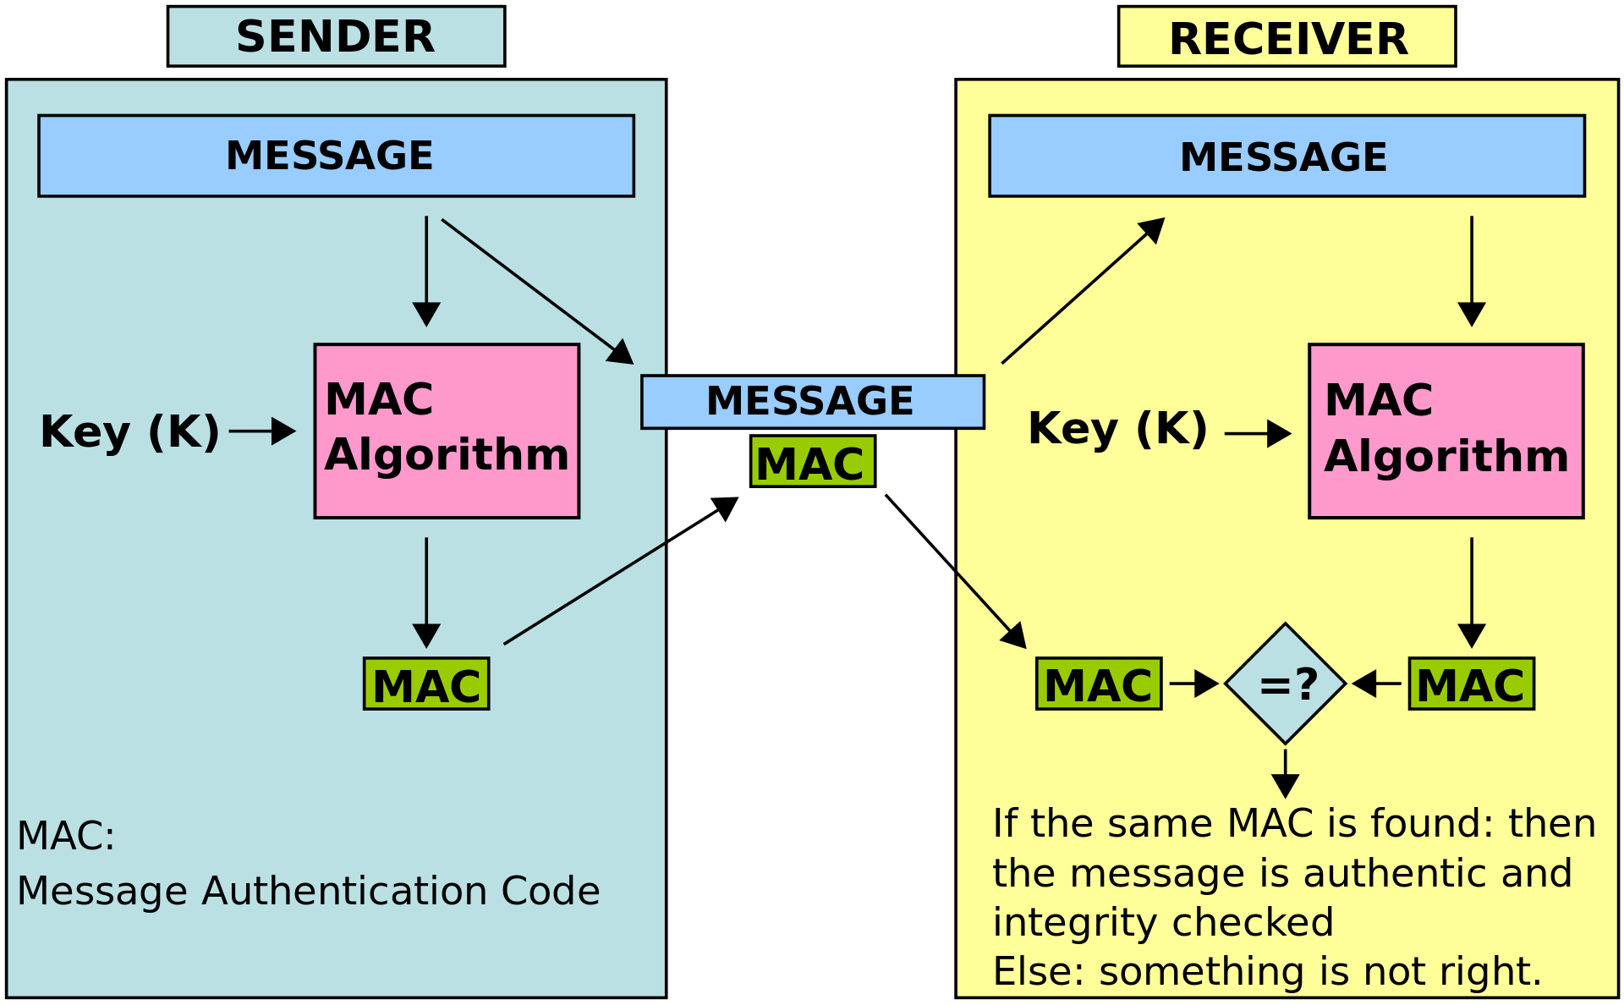
Message Authentication Code
tag
Collision
resistance
https://en.wikipedia.org/wiki/Message_authentication_code

Slide 53
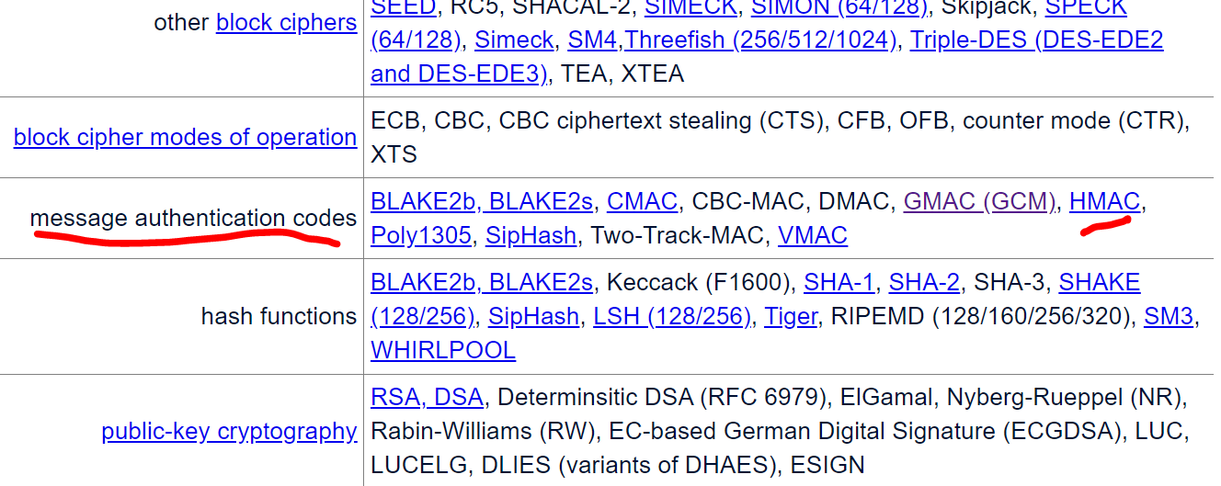
Message Authentication Code
CMAC: https://csrc.nist.gov/pubs/sp/800/38/b/upd1/final

Slide 54
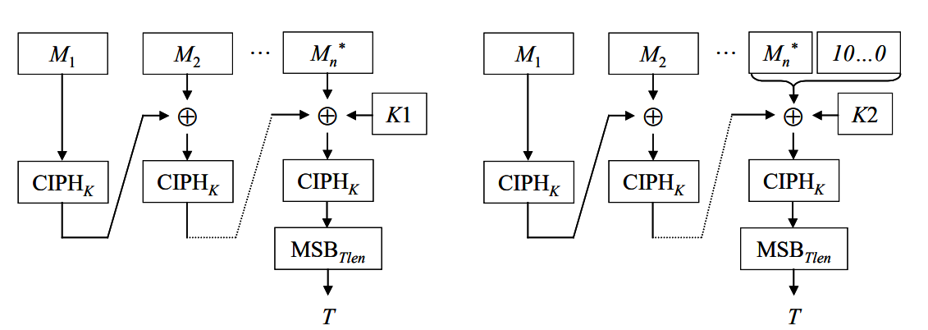
Message Authentication Code CMAC

Slide 55
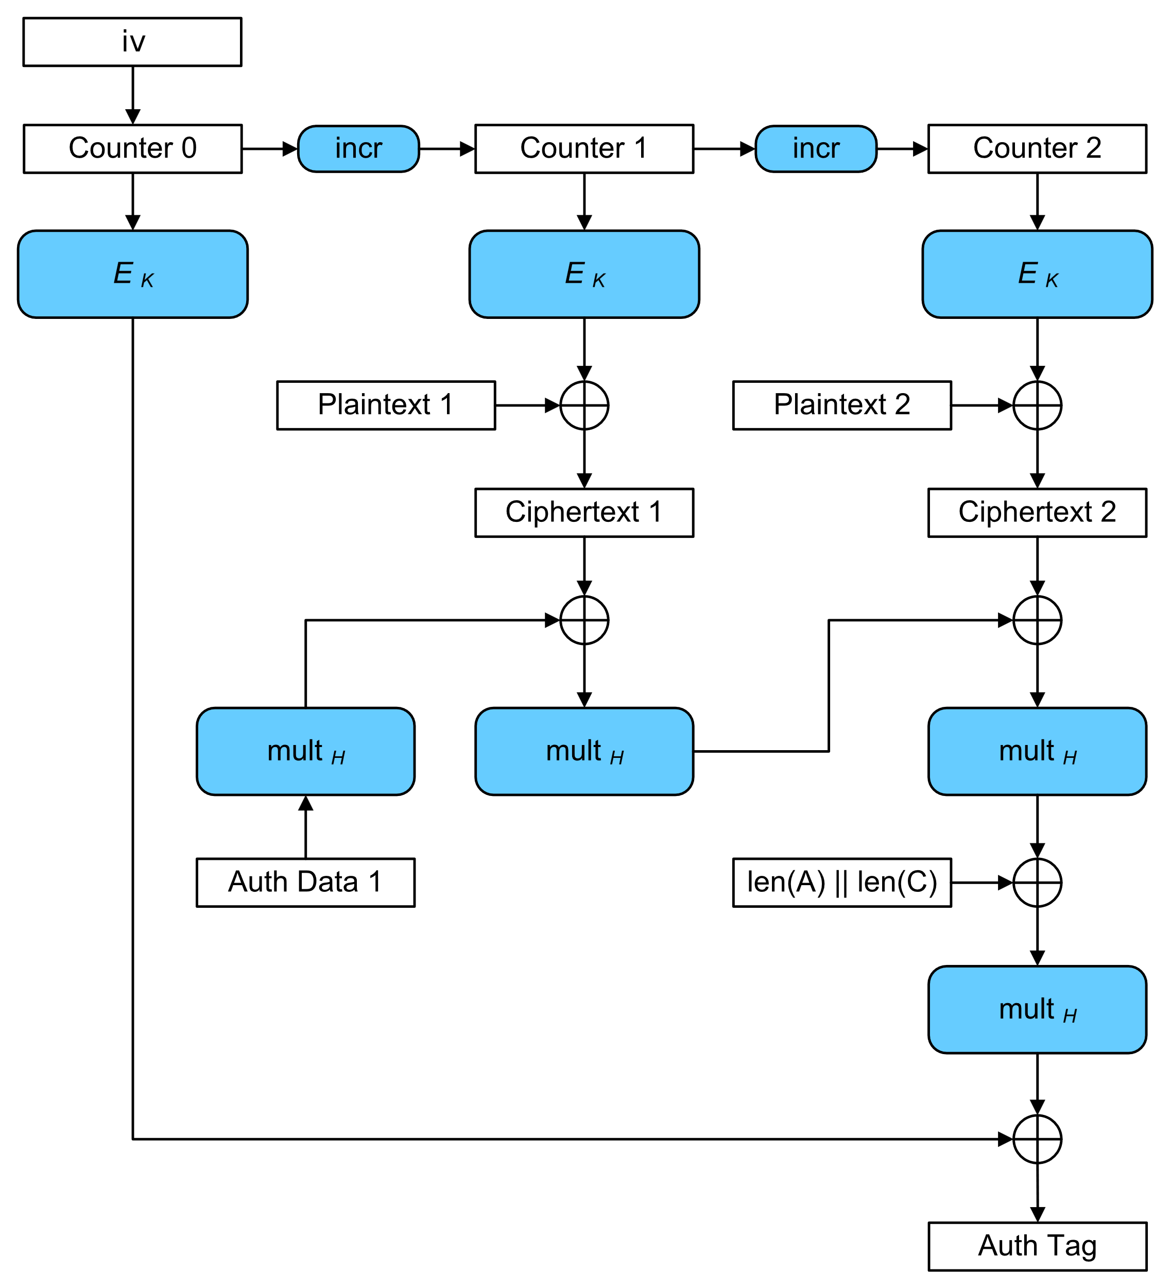
Message Authentication Code GMAC
….
n
….
n
….
n
GCM
….
….
Page 19 for
$$Mult_{H}$$
$$C=C_{1} || …||C_{n}$$
(C, auth tag)
https://csrc.nist.gov/pubs/sp/800/38/d/final
https://csrc.nist.gov/projects/crypto-publication-review-project

Slide 56
Keyed-Hash Message Authentication Code HMAC
A hash family (H) use for message authentication
MAC(K,M) = H_{K}(M)
The sender and the receiver share secret K
The sender sends (M, H_{k}(M))
The receiver receives (X,Y) and verifies that H_{K}(X)=Y, if so, then accepts the message as from the sender
To be secure, an adversary shouldn’t be able to come up with (X’,Y’) such that H_{K}(X’)=Y’.
$$K$$
$$K$$
$M$, tag=$H(K, M)$
$M^{′}, tag′=H(K,M′)$?=tag

Slide 57
Security Requirements for MAC
Resist the Existential Forgery under Chosen Plaintext Attack
Challenger chooses a random key K
Adversary chooses a number of messages M₁, M₂, .., M_{n}, and obtains t_{j}=MAC(K,M_{j}) for 1≤j≤n
Adversary outputs M’ and t’
Adversary wins if ∀j M’≠M_{j}, and t’=MAC(K,M’)
Basically, adversary cannot create the MAC for a message for which it hasn’t seen an MAC
Notes:
Good homework problem, break simple MAC constructions.
MAC uses shared secret key to bootstrap integrity/authenticity.

Slide 58
Constructing MAC from Hash Functions
Let h be a one-way hash function (SHA2)
MAC(K,M) = h(K || M), where || denote concatenation
Insecure as MAC
Because of the Merkle-Damgard construction for hash functions, given M and t=h(K || M), adversary can compute M’=M||Pad(M)||X and t’, such that h(K||M’) = t’

Slide 59
Constructing MAC from Cryptographic Hash Functions HMAC
HMAC_{K}[M] = Hash[(K⁺ ⊕ opad) || Hash[(K⁺ ⊕ ipad)||M)]]
K⁺ =$K||{\left\{0\right\}}^{∗}$(to B bytes, the input block size of the hash function)
ipad = 0x36 0x36 … 0x36 (repeated B times)
opad = 0x5C 0x5C …. 0x5C (repeated B times).
At high level, HMAC_{K}[M] = H(K || H(K || M))

Slide 60
Authentication and Integrity checking
$$K$$
$$K$$
$M$, $tag=h(K,M)$
h(K, M) = h[(K⁺ ⊕ opad) || Hash[(K⁺ ⊕ ipad)||M)]]
K⁺ =$K||{\left\{0\right\}}^{∗}$(to B bytes, the input block size of the hash function)
ipad = 0x36 0x36 … 0x36 (repeated B times)
opad = 0x5C 0x5C …. 0x5C (repeated B times).
Pros and Cons?

Slide 61



Authenticate user/end-devices case
(1) Password-based Authentication
$store:name, h(pw)$
$name, pw$
Login
Provide $name, pw′$ to server?
Locate the row using name
Check $h\left(pw^{′}\right)?=$ $h\left(pw\right)$
authenticate the user
Notes:
authentication factors= Các yếu

Slide 62
HMAC Security
If used with a secure hash functions (e.g., SHA3-256) and according to the specification (key size, and use correct output), no known practical attacks against HMAC

Slide 63
Dictionary attacks on hash function
h(password)= b1b6a3de29ab907153614683d357b2db943a317d036ff25f7022d4707109005a
password=?
Guest password | sha256 | sha384 | sha512 | …
abc123 | … | … | ….. | …
abcd1234 | … | …. | … | …
….
Rainbow table
https://hashkiller.io/

